Slide 1
SHA Implementation
Liam Kelly
ITIS 6240
Assignment 2

Slide 2
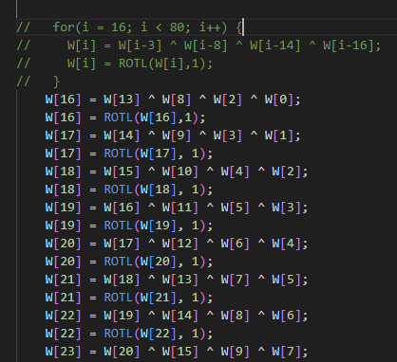
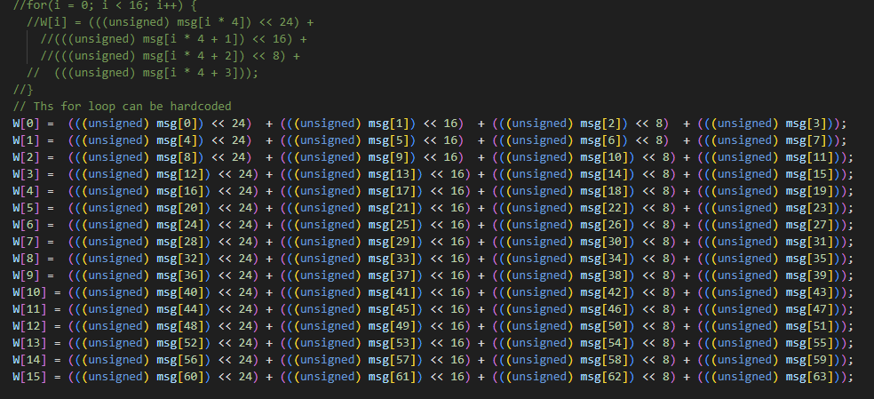
Edited Code: sha1_process()
In this function I broke apart two of the for-loops to avoid looping. Each loop became its own line and any arithmetic being calculated to get an index was precalculated and hardcoded.

Slide 3
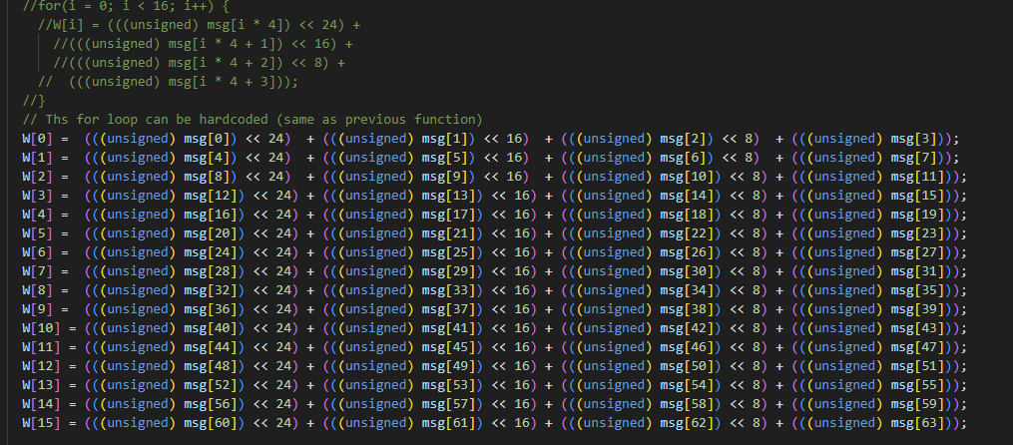
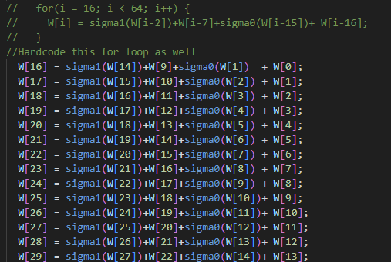
Edited Code: sha256_process()
Similar to the previous function, this for-loop can be replaced in the exact same way to avoid looping. The second for-loop removed was also similar to the previous function. All indexes were precalculated to avoid overhead

Slide 4

SHA 512
SHA 512 was not functioning on my machine, so I could not improve its implementation

Slide 5

Speed Comparisons
My Code (ShaO – Liam Kelly.c
Original Code (shaO.c)

